Slide 1

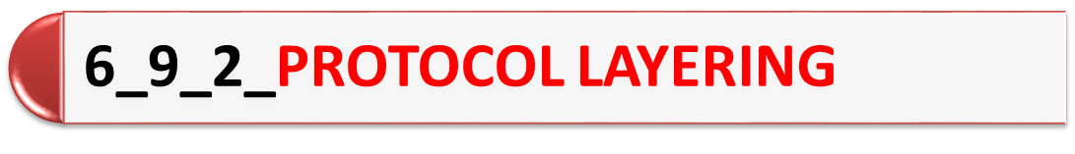
PDS
SDN
NFV
Computer Vision
https://github.com/siagianp
https://www.youtube.com/@AmelOline/videos
https://github.com/amelcharolinesgn2/IoT_simulator-mqtt-NodeRed
https://github.com/amelcharolinesgn2/Cloud-Incomastructures
https://github.com/amelcharolinesgn2/ClouD-Incomastructure-SISKA-2025
Notes:
http://www.sophphx.caltech.com/Physics_5/Experiment_6.pdf

Slide 2
Introduction
In data communication and networking, a protocol defines the rules that both the sender and receiver and all intermediate devices need to follow to be able to communicate effectively.
When communication is simple, we may need only one simple protocol;
when the communication is complex, we may need to divide the task between different layers, in which case we need a protocol at each layer, or protocol layering.

Slide 3
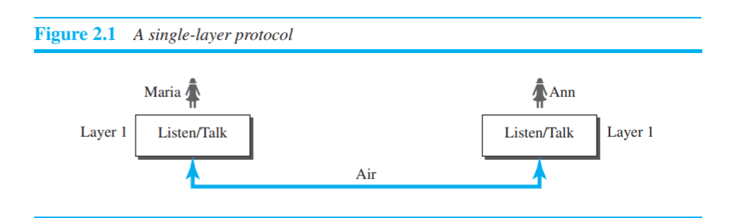
To understand the need for protocol layering
Scenarios

Slide 4
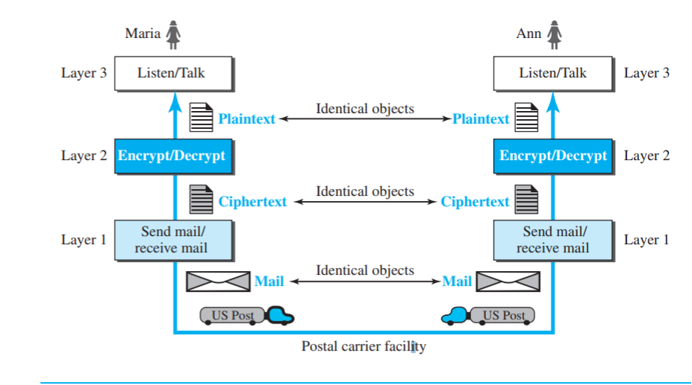

Slide 5
What are layered protocols?
A layered protocol architecture provides a conceptual framework for dividing the complex task of exchanging information between remote hosts into simpler tasks.
Each protocol layer has a narrowly defined responsibility.
Protocol layer provides a standard interface to the next higher protocol layer.

Slide 6
Why are network protocol layers important?
In order for computers with different hardware and operating systems to be able to communicate effectively over a network or an internet,
it is clearly important for there to be a uniform set of protocols and standards which the communicating systems and applications will conform to.

Slide 7
What are the two principles of protocol layering?
The first principle dictates that if we want bidirectional communication, we need to make each layer so that it is able to perform two opposite tasks, one in each direction.
The second principle that we need to follow in protocol layering is that the two objects under each layer at both sites should be identical.

Slide 8
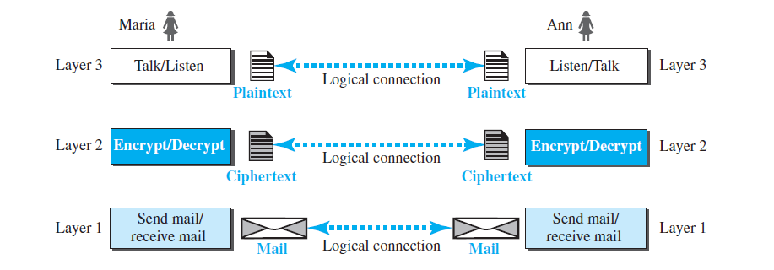
Logical Connections
Maria and Ann can think that there is a logical (imaginary) connection at each layer through which they can send the object created from that layer.

Slide 9
Protocol “layers” and reference models
Networks are complex,
with many “pieces”:
  hosts
  routers
  links of various media
  applications
  protocols
  hardware, software
Question: is there any hope of organizing structure of network?
and/or our discussion of networks?

Slide 10

Example: organization of air travel
end-to-end transfer of person plus baggage
ticket (purchase)
baggage (check)
gates (load)
runway takeoff
airplane routing
ticket (complain)
baggage (claim)
gates (unload)
runway landing
airplane routing
airplane routing
How would you define/discuss the system of airline travel?
a series of steps, involving many services

Slide 11
Example: organization of air travel
ticket (purchase)
baggage (check)
gates (load)
runway takeoff
airplane routing
ticketing service
ticket (complain)
baggage (claim)
gates (unload)
runway landing
airplane routing
baggage service
gate service
runway service
routing service
airplane routing
layers: each layer implements a service
  via its own internal-layer actions
  relying on services provided by layer below

Slide 12
Why layering?
Approach to designing/discussing complex systems:
explicit structure allows identification, relationship of system’s pieces
  layered reference model for discussion
modularization eases maintenance, updating of system
  change in layer's service implementation: transparent to rest of system
  e.g., change in gate procedure doesn’t affect rest of system

Slide 13
Layered Internet protocol stack
application: supporting network applications
  HTTP, IMAP, SMTP, DNS
transport: process-process data transfer
  TCP, UDP
network: routing of datagrams from source to destination
  IP, routing protocols
link: data transfer between neighboring network elements
  Ethernet, 802.11 (WiFi), PPP
physical: bits “on the wire”
application
application
transport
transport
network
network
link
link
physical
physical

Slide 14

Services, Layering and Encapsulation
application
transport
network
link
physical
M
application
transport
network
link
physical
Application exchanges messages to implement some application service using services of transport layer
H_{t}
M
Transport-layer protocol transfers M (e.g., reliably) from one process to another, using services of network layer
transport-layer protocol encapsulates application-layer message, M, with transport layer-layer header H_{t} to create a transport-layer segment
  H_{t} used by transport layer protocol to implement its service
source
destination

Slide 15
Services, Layering and Encapsulation
application
transport
network
link
physical
M
application
transport
network
link
physical
H_{t}
M
Transport-layer protocol transfers M (e.g., reliably) from one process to another, using services of network layer
H_{n}
H_{t}
M
Network-layer protocol transfers transport-layer segment [H_{t} | M] from one host to another, using link layer services
network-layer protocol encapsulates transport-layer segment [H_{t} | M] with network layer-layer header H_{n} to create a network-layer datagram
  H_{n} used by network layer protocol to implement its service
source
destination

Slide 16
Services, Layering and Encapsulation
application
transport
network
link
physical
M
application
transport
network
link
physical
H_{t}
M
H_{n}
H_{t}
M
Network-layer protocol transfers transport-layer segment [H_{t} | M] from one host to another, using link layer services
H_{l}
H_{n}
H_{t}
M
Link-layer protocol transfers datagram [H_{n}| [H_{t} |M] from host to neighboring host, using network-layer services
link-layer protocol encapsulates network datagram [H_{n}| [H_{t} |M], with link-layer header H_{l} to create a link-layer frame
source
destination

Slide 17
Services, Layering and Encapsulation
application
transport
network
link
physical
M
application
transport
network
link
physical
M
message
H_{t}
M
H_{t}
M
segment
H_{n}
H_{t}
M
H_{n}
H_{t}
M
datagram
H_{l}
H_{n}
H_{t}
M
H_{l}
H_{n}
H_{t}
M
frame
source
destination

Slide 18
Encapsulation: an end-end view
source
message
M
application
transport
network
link
physical
segment
H_{t}
M
H_{t}
datagram
H_{n}
H_{t}
M
H_{n}
frame
H_{l}
H_{n}
H_{t}
M
link
physical
switch
destination
H_{n}
H_{t}
M
network
link
physical
M
application
transport
network
link
physical
H_{l}
H_{n}
H_{t}
M
H_{n}
H_{t}
M
H_{t}
M
H_{n}
H_{t}
M
H_{l}
H_{n}
H_{t}
M
router

Slide 19
PDS
SDN
NFV
Computer Vision
Thank You !!
https://github.com/siagianp
https://www.youtube.com/@AmelOline/videos
https://github.com/amelcharolinesgn2/IoT_simulator-mqtt-NodeRed
https://github.com/amelcharolinesgn2/Cloud-Incomastructures
https://github.com/amelcharolinesgn2/ClouD-Incomastructure-SISKA-2025

